Slide 1
Get hooked on react hooks

Slide 2
Topics
Brief Introduction to React
Basic Concepts in React
What are React Hooks?
Why React Hooks?
Pros and Cons of React Hooks
Demo

Slide 3

Brief introduction to react

Slide 4
Basic Concepts in react
Component
State
Lifecycle Methods
Context

Slide 5
Component
JavaScript function or class that optionally accepts inputs (or so called props), and returns a React element that describes how a section of the UI should appear
Independent, reusable pieces of code
Building block of the UI

Slide 6

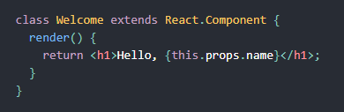
Functional component
Class-based component

Slide 7
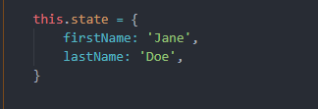
State
Object that determines how the specific component renders & behaves

Slide 8
Lifecycle Methods
Every component follows a cycle from when it’s created and mounted on the DOM to when it is unmounted and destroyed
Methods that get called at a certain point in the lifecycle of the component

Slide 9
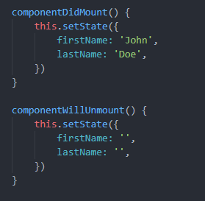
4 types:
Mounting
Updating
Unmounting
Errors

Slide 10
Context
Provides a way to share values between components without having to explicitly pass a prop through every level of the tree

Slide 11
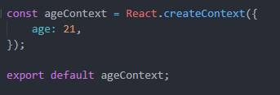
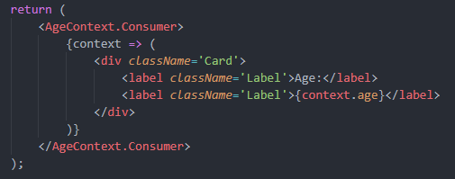
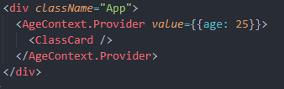

Slide 12
What are react hooks?
Javascript functions which let you “hook into” React state and lifecycle methods
Naming convention: use{Something}
useState()
useEffect()
useContext()

Slide 13
Rules of using hooks
ONLY CALL HOOKS AT THE TOP LEVEL!
ONLY CALL HOOKS FROM REACT FUNCTIONS!

Slide 14
Why React hooks?
3 major problems faced by react developers:
stateful logic is hard to reuse and leads to complex nesting (components, providers, consumers, higher order components etc.)
some components are becoming really huge and hard to manage, and sometimes it’s really hard or even impossible to split them into smaller components
JavaScript classes are confusing for people (just think about the usage of “this” in JavaScript classes)

Slide 15
Pros and cons of react hooks
Pros:
Functional programming
Smaller and simpler components
Less lines of code
Reusable code with custom hooks
Less levels of nesting in the DOM
No need to use “this”
No need for binding
Non-breaking change
Cons:
Functional programming
Another feature that needs to be learned
New feature
Less examples available
Lack of support from some popular packages

Slide 16


Slide 17


Slide 18


